Slide 1
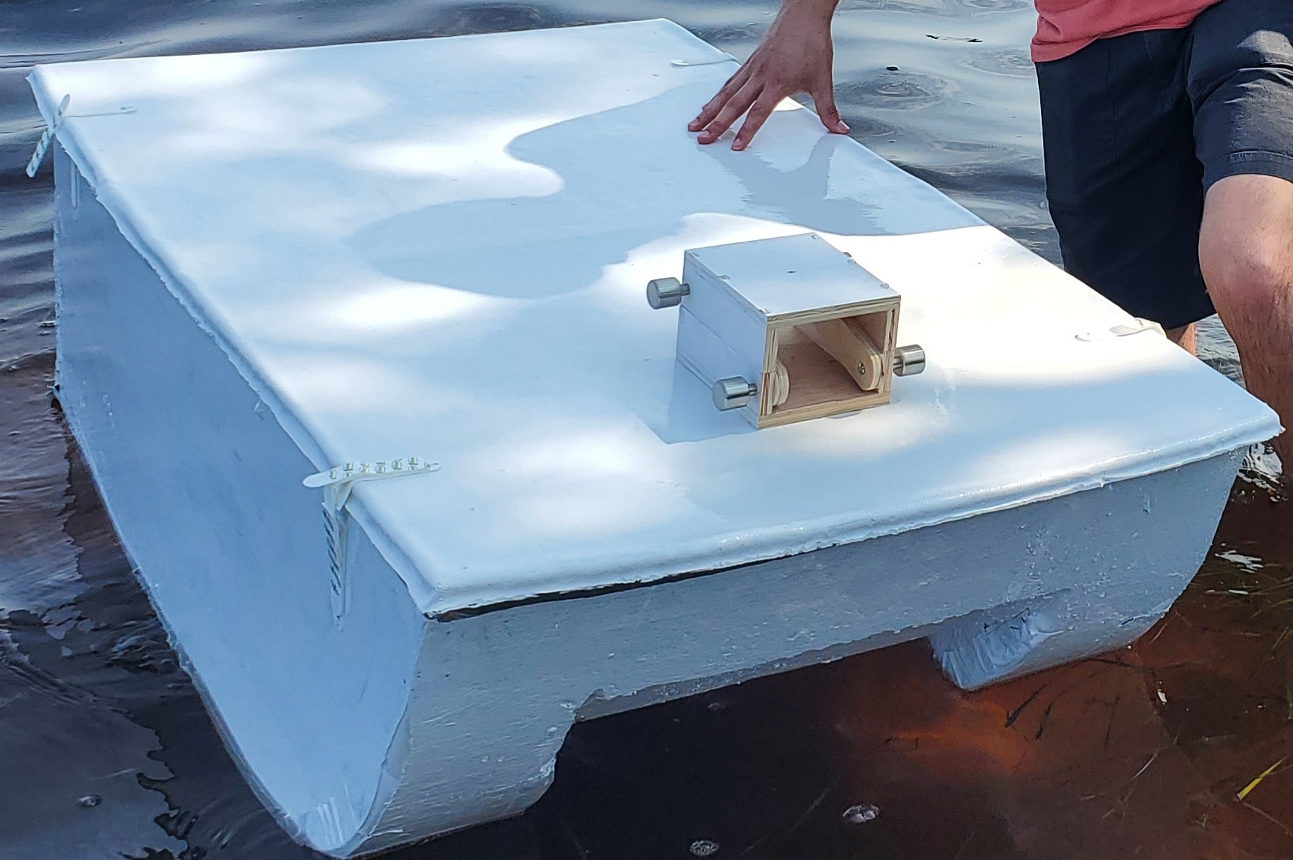



Final Presentation Team 524PC RoboBoat Pt. 1
By: Tamara McCaskill, Joseph Earnest, Manning Owens, Steven Harrington, Bryson Potts

Slide 2
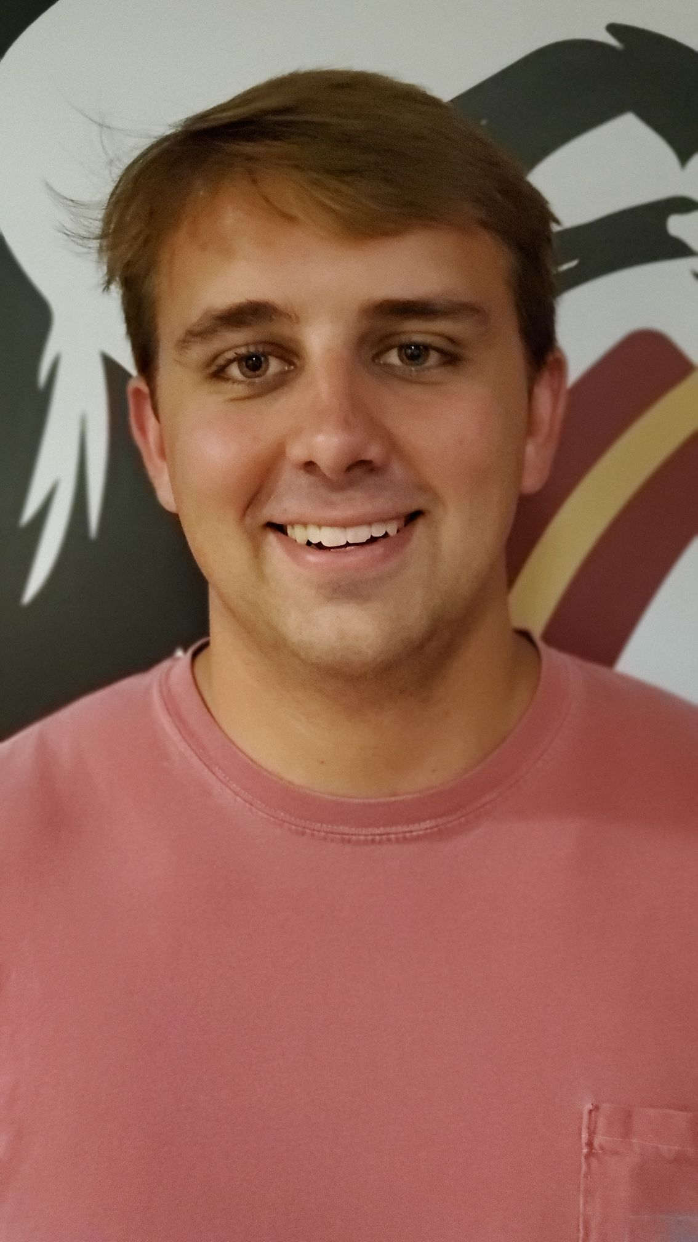

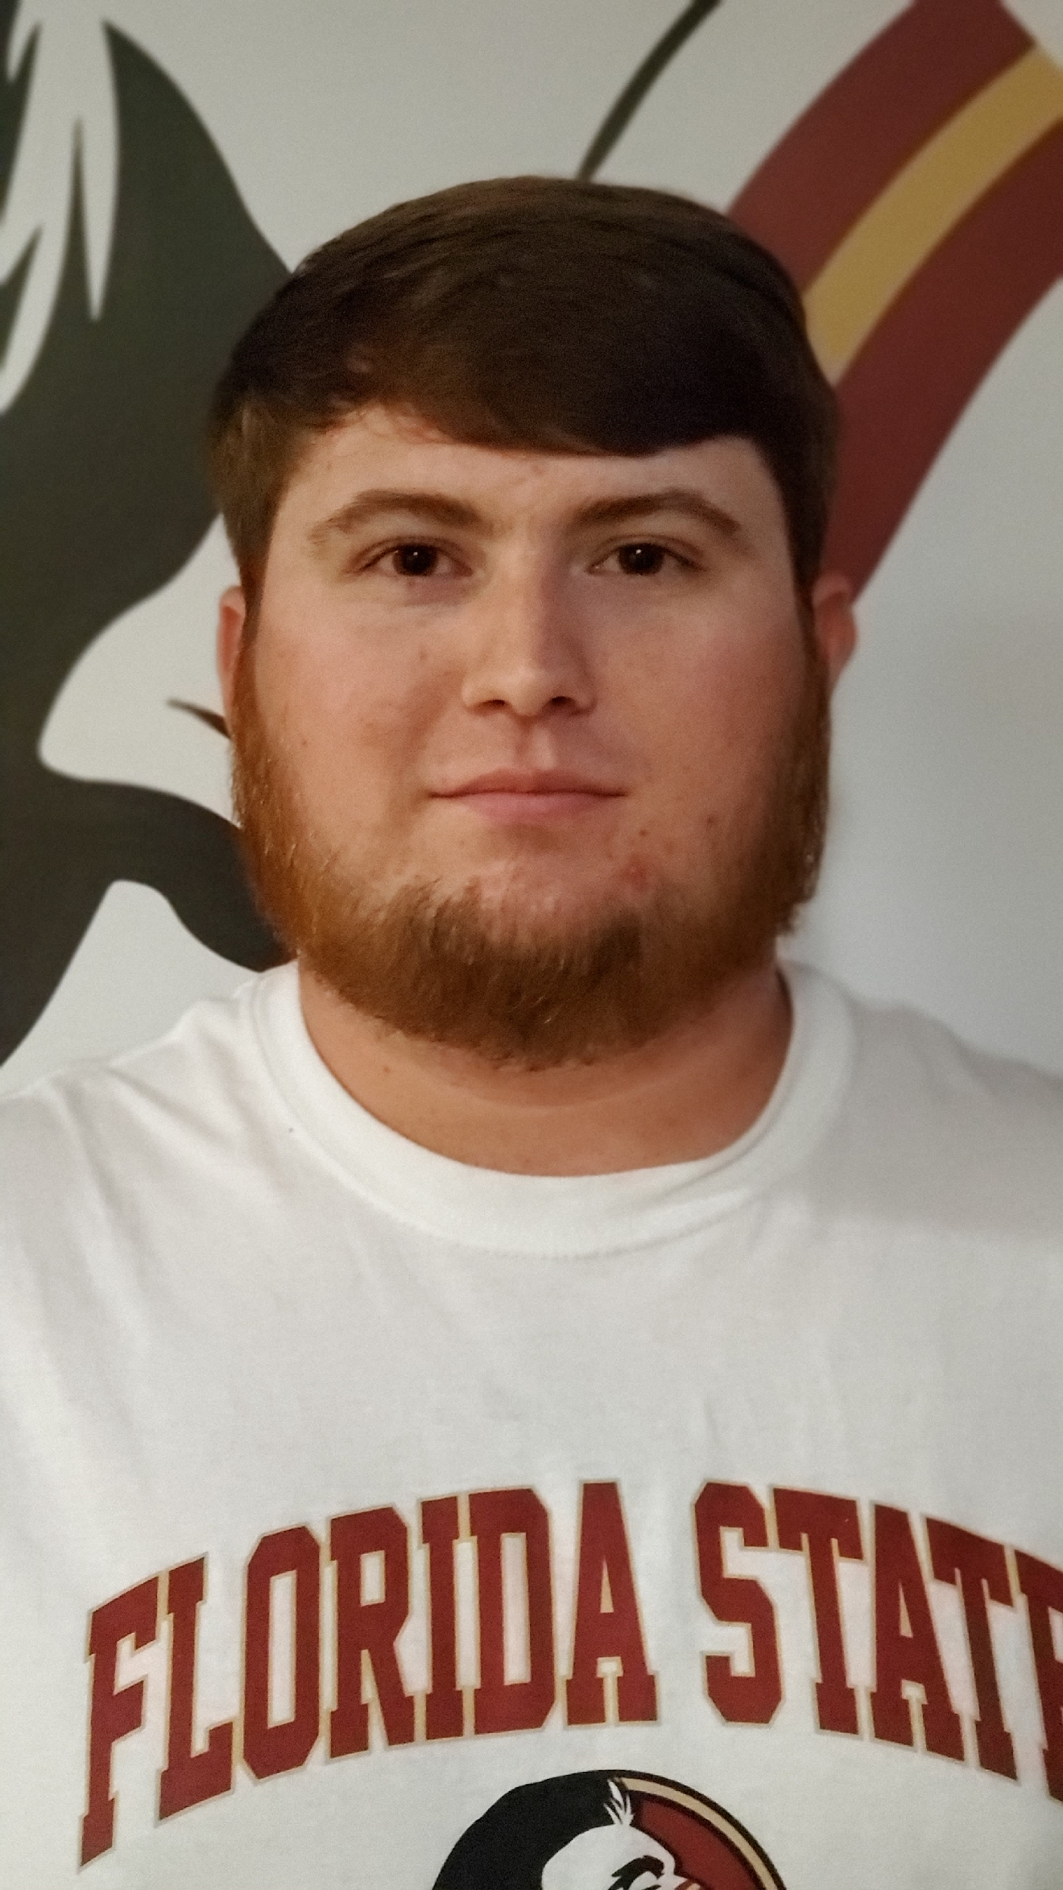

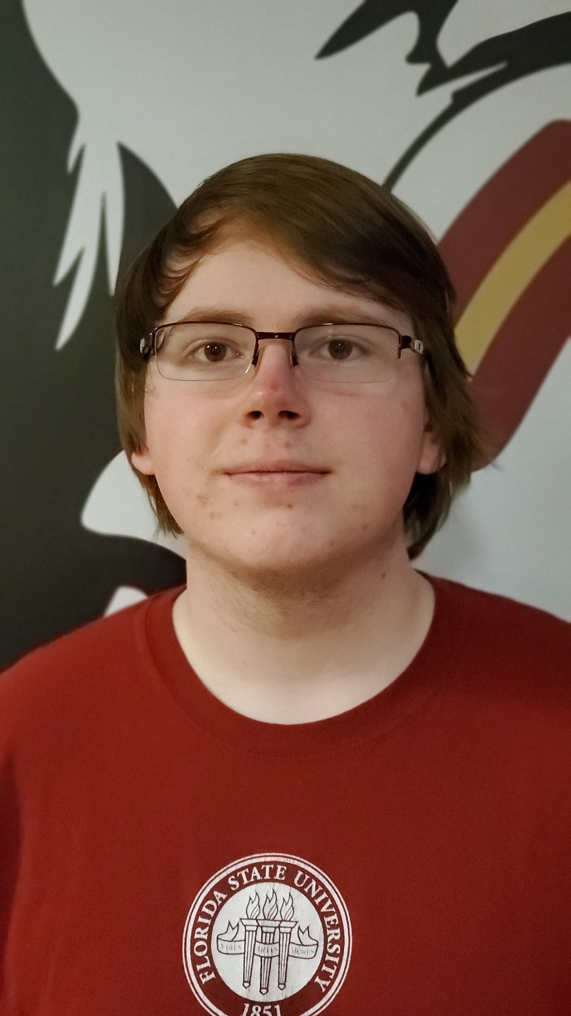
The Team
Bryson Potts
Design Engineer
Joseph Earnest
Design Engineer
Manning Owens
Design Engineer
Tamara McCaskill
Design Engineer
Steven Harrington
Design Engineer
Tamara McCaskill 2

Slide 3
Project Overview
This project aims to demonstrate the skills acquired through our mechanical engineering program by designing and constructing a ship with autonomous functions that can complete the course objectives of the 2021 RoboBoat competition.
Tamara McCaskill 3

Slide 4
Competition Background
RoboBoat is an international competition hosted by RoboNation in Daytona, Florida.
Competitors create autonomous surface vehicles (ASVs) to complete simplified tasks.
These tasks simulate real-world challenges in the maritime industry, such as surveillance, object delivery, and navigation.
Tamara McCaskill 4

Slide 5
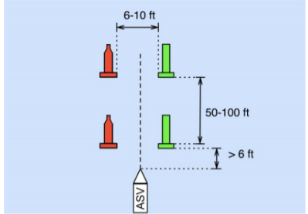
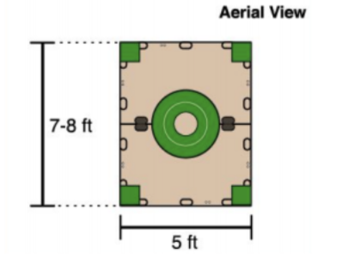
Example Tasks…..
Navigation Challenge
Object Delivery Challenge
Tamara McCaskill 5

Slide 6
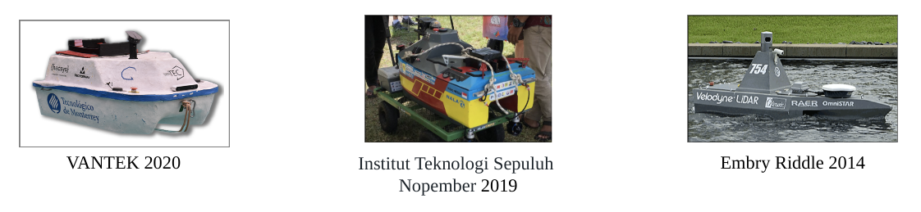
Previous Overall Competition Winners
Tamara McCaskill 6

Slide 7
Due to COVID….
This year’s RoboBoat 2021 competition was held online.
Required Deliverables Included:
Short Skills Video
Detailed Technical Report
Team Website Page
https://pcspear.org/the-2020-2021-team/
Tamara McCaskill 7

Slide 8
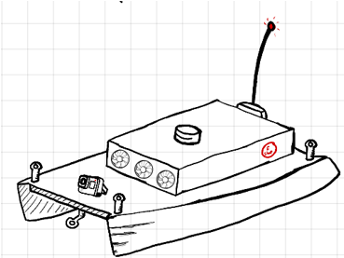
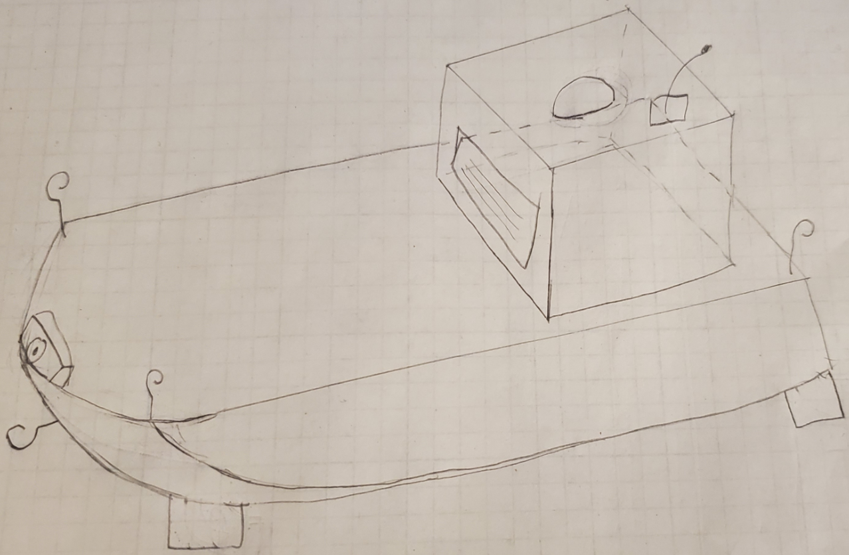
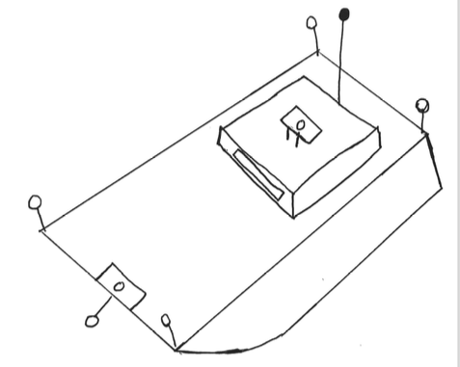
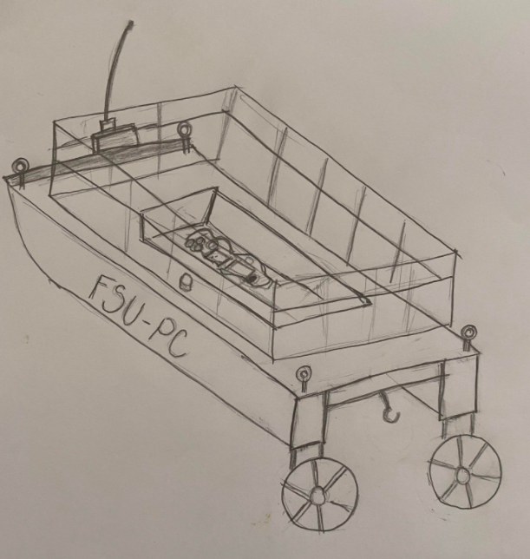
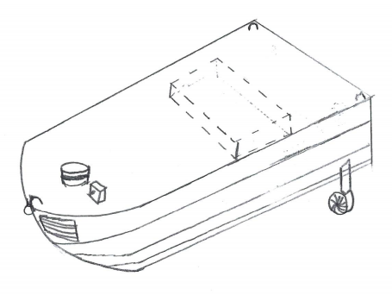
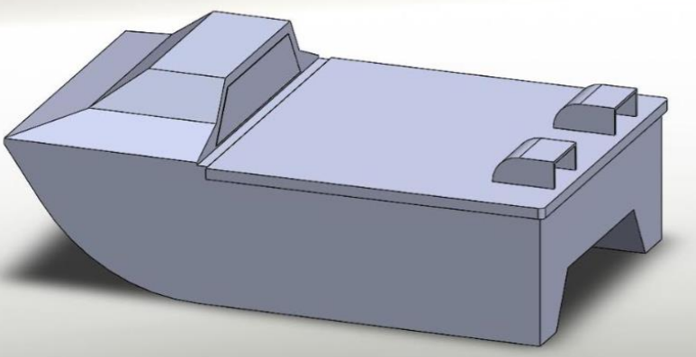
Preliminary Designs
Joseph Earnest 8

Slide 9
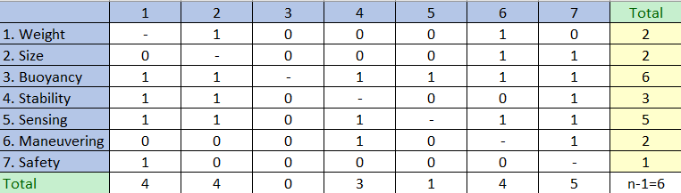
Concept Selection – Binary Comparison
Joseph Earnest 9

Slide 10
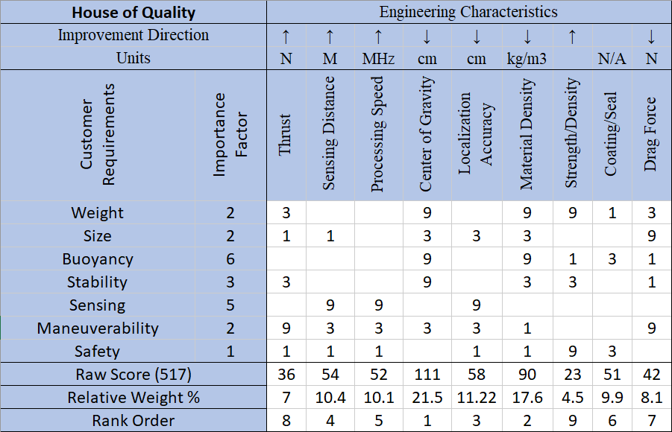
Concept Selection – House of Quality
Joseph Earnest 10

Slide 11
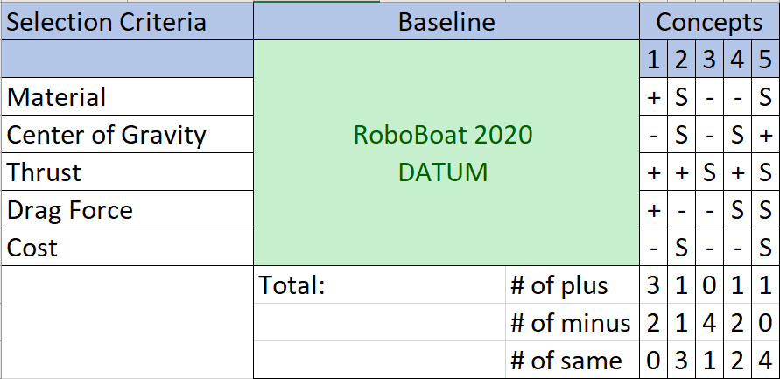
Concept Selection – Pugh Chart
Joseph Earnest 11

Slide 12
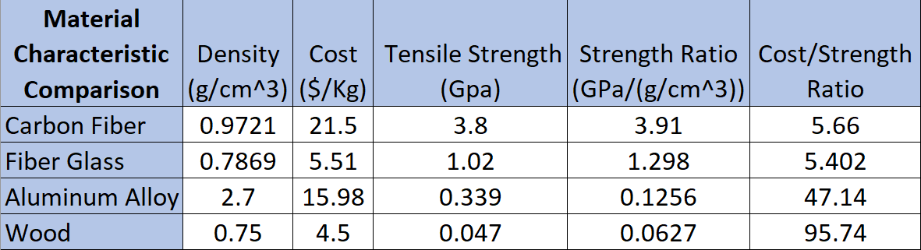
Concept Selection – Characteristic Comparison
Joseph Earnest 12

Slide 13
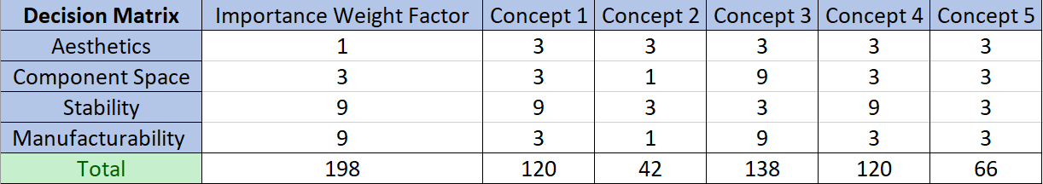
Concept Selection – Decision Matrix
Joseph Earnest 13

Slide 14
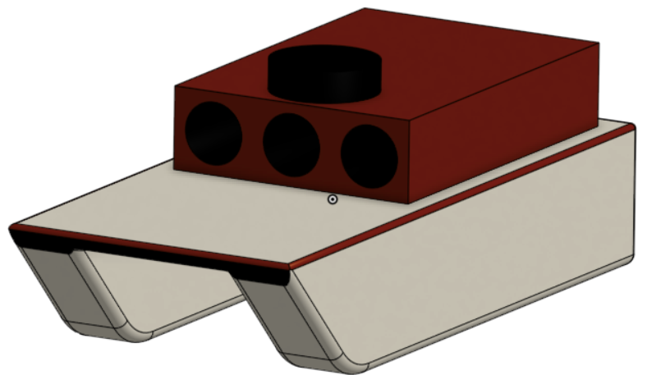
Concept Selection – Final Concept
Joseph Earnest 14

Slide 15



Questions? B.O.A.T (Best of All Time)

